Slide 1
HEALTHCARE ANALYSIS

Slide 2
INTRODUCTION
Blood datasets are essential tools in the field of medical research, clinical diagnostics, and public health initiatives. These datasets typically contain a variety of hematological and blood chemistry information, including blood cell counts, hemoglobin levels, glucose, cholesterol, and electrolyte values. These data points are invaluable for analyzing various health conditions, identifying risk factors, and assessing treatment efficacy. With advancements in machine learning, blood datasets are increasingly being used to develop predictive models for diagnosing diseases, predicting patient outcomes, and enhancing personalized care.
The dataset under analysis in this study includes attributes such as Recency, Frequency, Monetary, Time, and Class. These attributes measure different aspects of blood donation behavior, making the dataset useful for analyzing donation patterns and classifying donors based on various parameters. This can provide insights into donor retention and the overall effectiveness of blood donation campaigns.

Slide 3
OBJECTIVE
Donor Segmentation: Grouping donors based on their behavior (recency, frequency, and monetary
contributions) to identify patterns and trends in blood donations.
Predictive Modeling: Using machine learning techniques to predict whether a donor will donate blood again
in the future based on historical data.
Insight Generation: Analyzing the dataset to generate actionable insights, such as which groups of donors are
more likely to be retained and how donor engagement can be improved.
Improving Healthcare Outcomes: Leveraging the findings to assist in the development of targeted strategies to
enhance blood donation rates, ensuring an adequate and continuous supply of blood for medical needs.

Slide 4
PYTHON
In this project, Python played a crucial role in data analysis and machine learning. I utilized libraries such as Pandas for data manipulation and cleaning, allowing me to preprocess the blood donor dataset efficiently. For exploratory data analysis (EDA), I employed Seaborn and Matplotlib to visualize trends and relationships within the data.
Additionally, I implemented various machine learning algorithms from Scikit-learn, including Logistic Regression, Decision Trees, and Random Forest, to build predictive models that classify donor behavior. This integration of Python's powerful data analysis and machine learning capabilities enabled me to derive meaningful insights and improve blood donation predictions effectively.

Slide 5
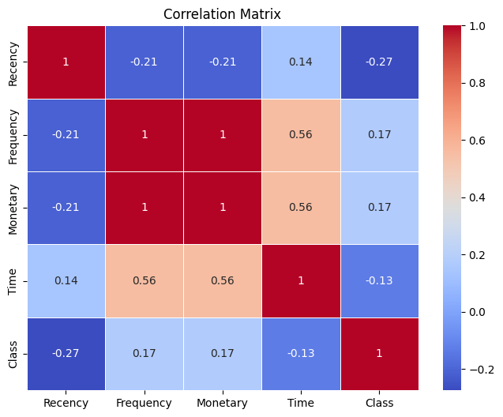
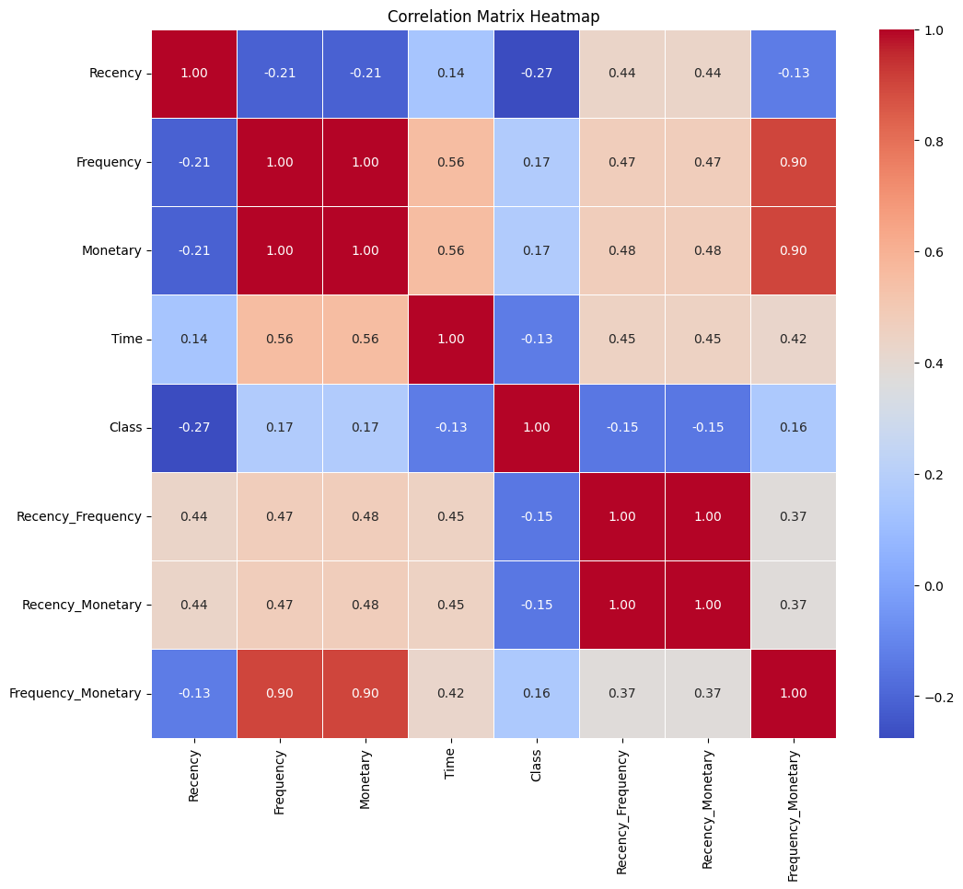

Slide 6
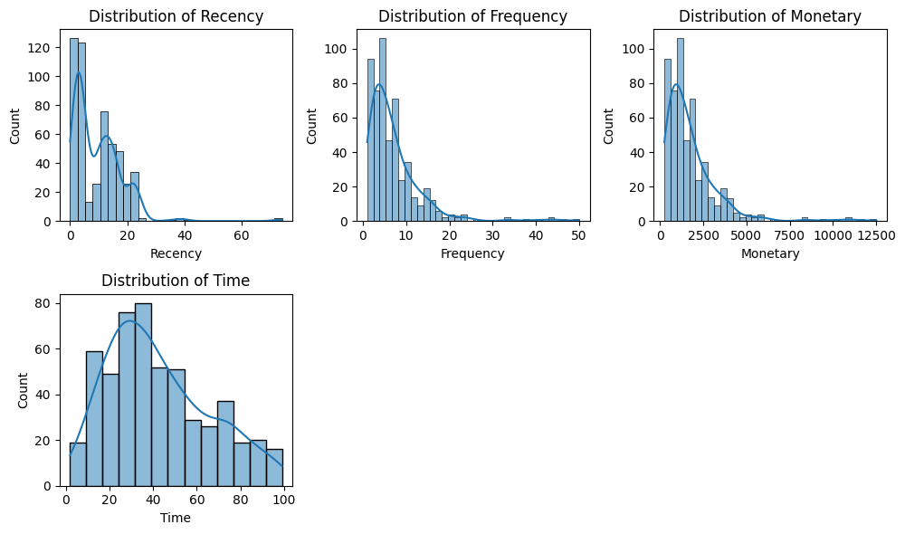
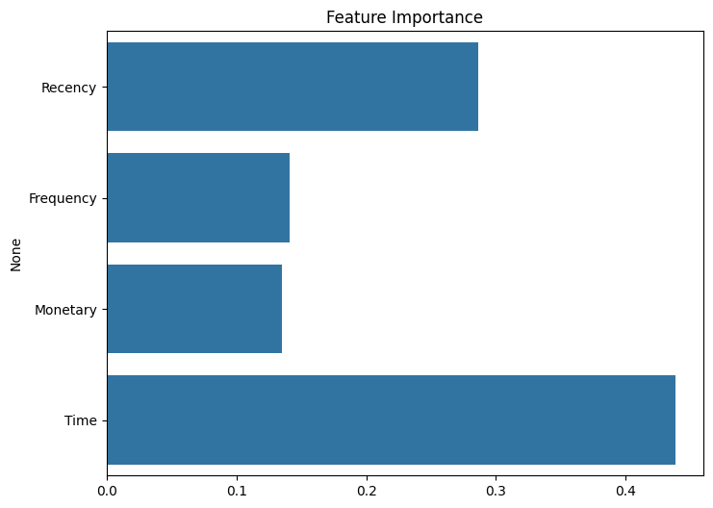

Slide 7
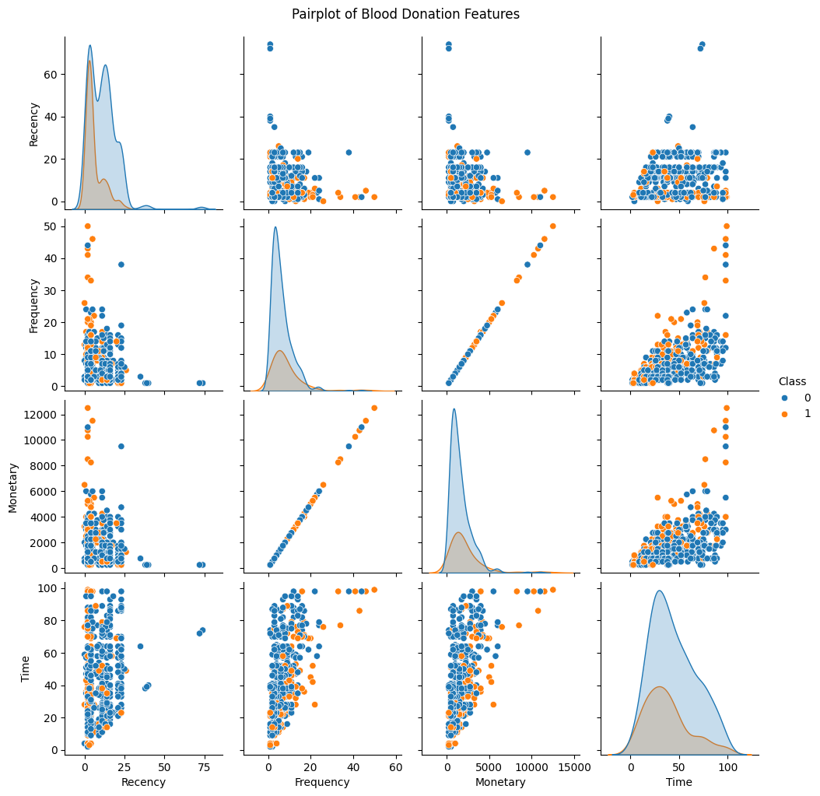
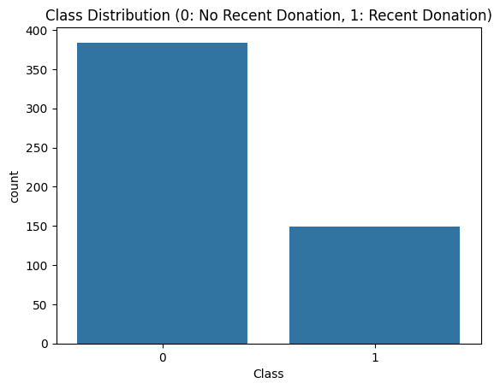
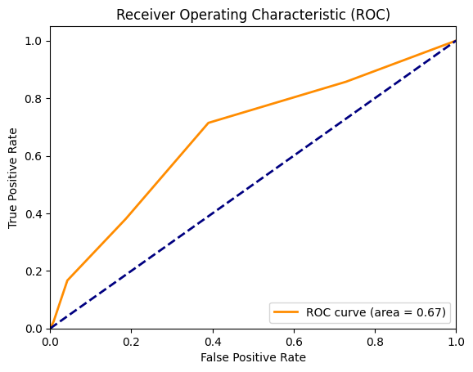

Slide 8
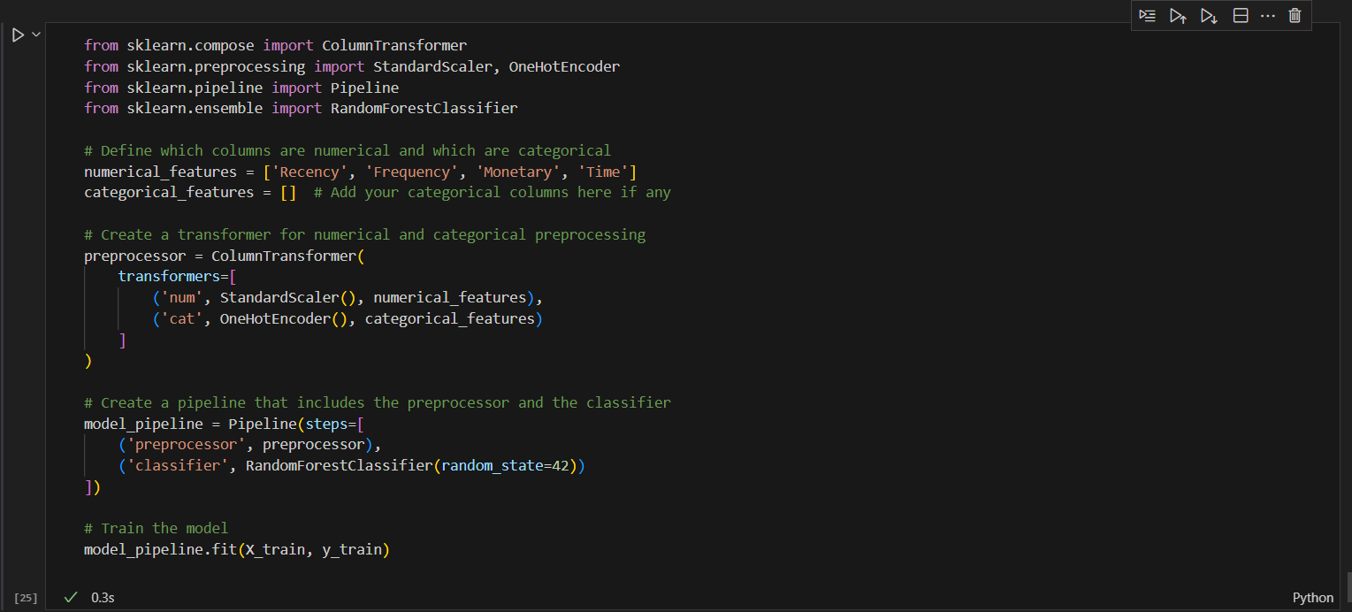
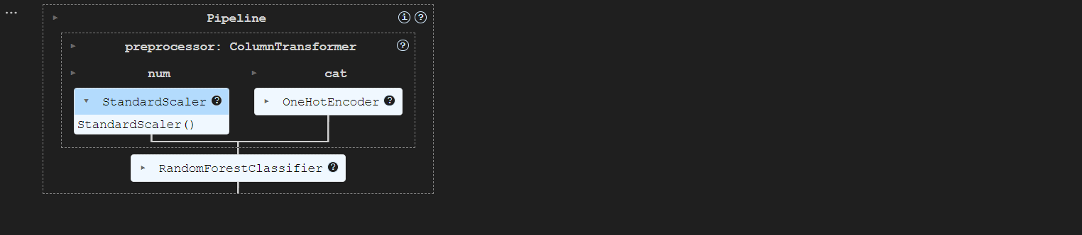

Slide 9
MY SQL
In this project, I utilized MySQL to efficiently manage and analyze the blood donor dataset. My SQL queries facilitated complex data manipulations, allowing me to perform intricate joins, aggregations, and filtering to extract meaningful insights. By structuring the database effectively, I ensured seamless data retrieval and improved performance for exploratory data analysis. My experience with SQL enhanced my ability to derive actionable insights and support data-driven decision-making within the context of blood donation predictions.

Slide 10
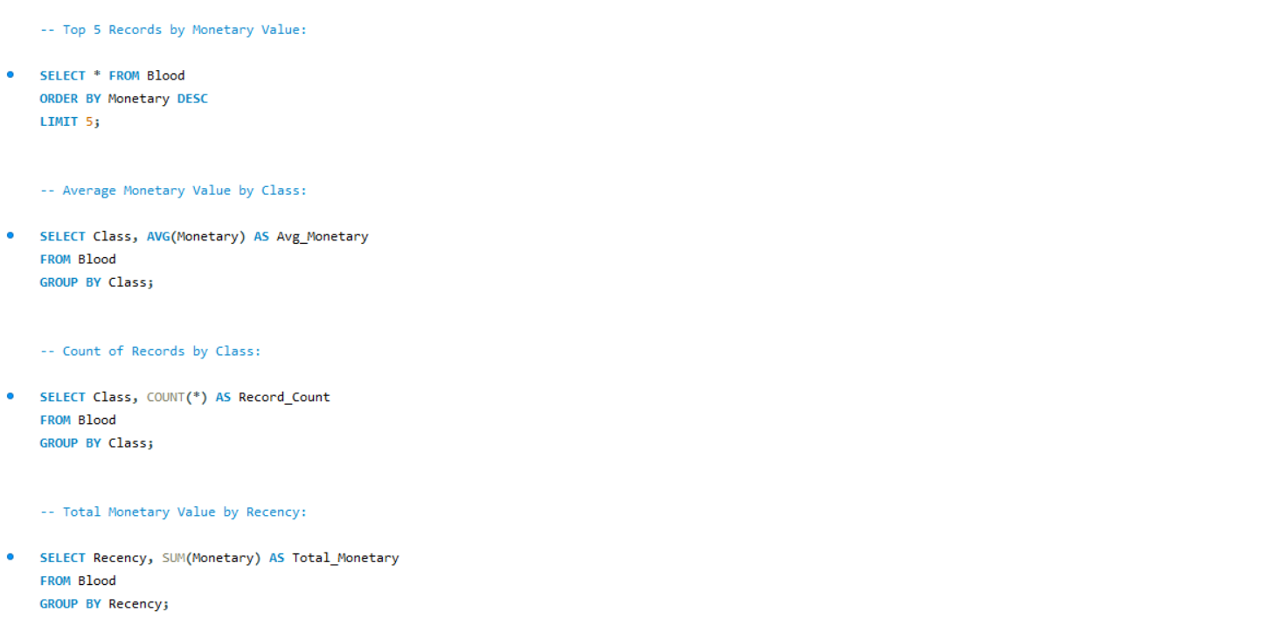

Slide 11
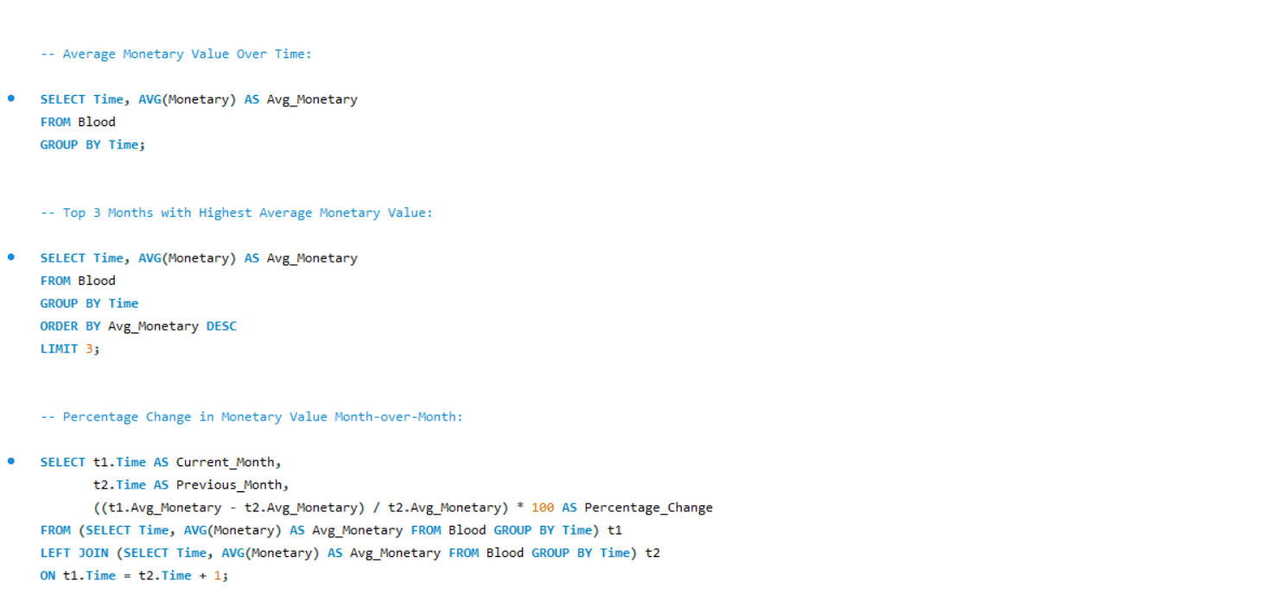

Slide 12
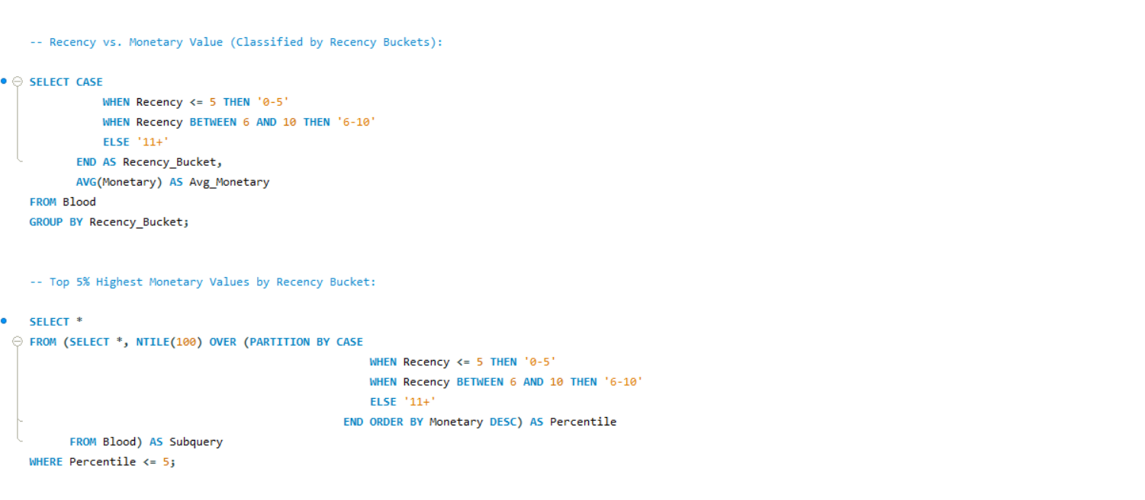

Slide 13
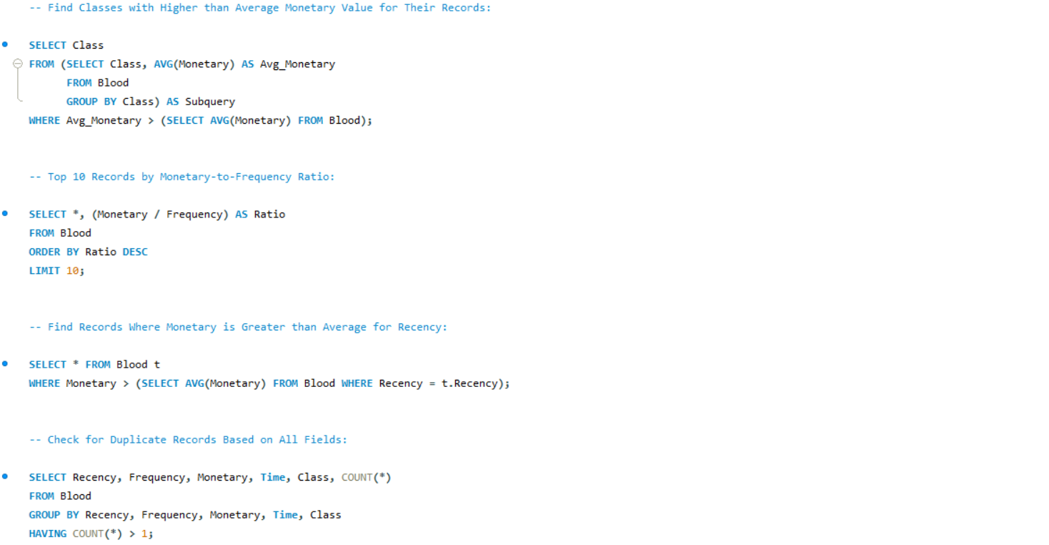

Slide 14
CONCLUSION
In summary, blood datasets offer a wealth of information that contributes to advancing medical research,
improving clinical practices, and promoting better health outcomes. They are pivotal for understanding
hematological health and for the development of innovative healthcare solutions through data-driven insights.

Slide 15


VISIT FOR DETAILED PROJECT
Click on linkedin logo to visit my Profile
Click on Github logo to visit the portfolio of the project

